Slide 1
Malvertisement Detection using Machine Learning
By:
Rajat Kapgate
Prajakta Bonde
Siddharth Singh

Slide 2
Problem Statement
A malvertisement (malicious advertisement) is an advertisement on the Internet that is capable of infecting the viewer's computer with malware.
Malvertising can be extremely hard to combat because it can quietly work its way into a webpage or advertisement on a webpage and spread unknowingly.
Malvertising takes advantage of the same methods that distribute normal online advertising. Fraudsters submit infected graphic or text ads to legitimate advertisement networks, which often can’t distinguish harmful ads from trustworthy ones.
Our goal is to broadly detect malicious and fraudulent activities that exploit display ads by probabilistic classification using Natural Language Processing and Machine Learning algorithms.

Slide 3
Banner ads
Banner advertising refers to the use of a rectangular graphic display that stretches across the top, bottom, or sides of a website or online media property.
Banner ads are image-based rather than text-based and are a popular form of online advertising.
The purpose of banner advertising is to promote a brand and/or to get visitors from the host website to go to the advertiser's website.
Banner ads is the choice for most scammers to trick gullible, naive users into downloading malware onto their systems or providing private information to be misused by said scammers.

Slide 4
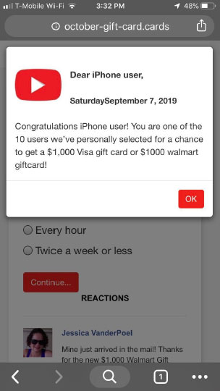
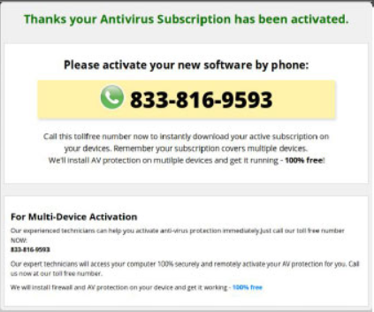
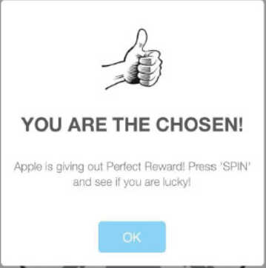

Slide 5
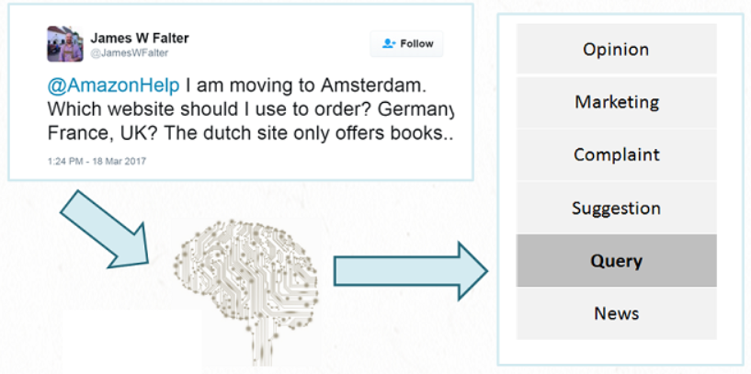
Intent Analysis
Sentiment analysis is contextual mining of text which identifies and extracts subjective information in source material, and helping a business to understand the social sentiment of their brand, product or service while monitoring online conversations.
Intent analysis steps up the game by analyzing the user’s intention behind a message and identifying whether it relates an opinion, news, marketing, complaint, suggestion, appreciation or query.

Slide 6
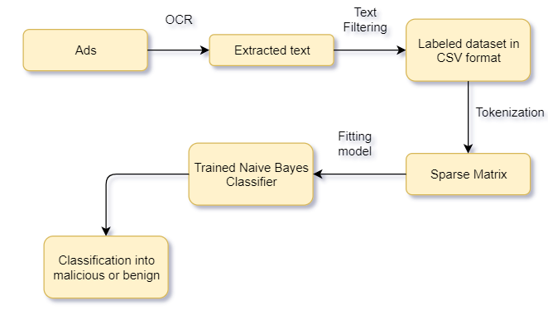
Flow Diagram

Slide 7

Text extraction using OCR
The Python-Tesseract aka Pytesseract library (which is a wrapper for Google’s Tesseract-OCR engine) was used for Optical Character Recognition of the text in the ads.
sdssdsd
become avon independent sales representative make money make your hours work home work online sne

Slide 8
Text Filtering
The extracted text was then filtered as a part of the data pre-processing step. The filtering included:
Removal of new line delimiter
Removal of digits and punctuation
Consideration of only alphabetical characters
Stopwords removal (eg: a, an ,in, by, etc)
SpellChecker (eg: hous => house)

Slide 9
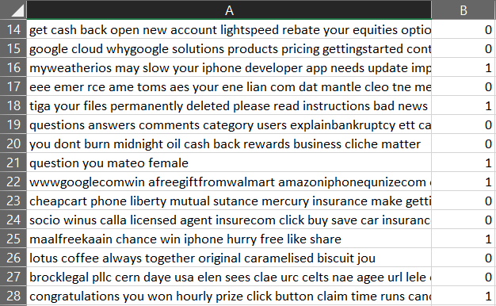
Dataset
.csv format
2 columns:
Col 1: Ad words
Col 2: Label (Malicious: 1 Benign: 0 )

Slide 10
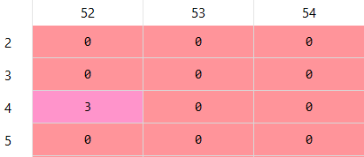
Tokenization
The input strings of each image is tokenized by characters
The Count Vectorizer was used to create bag of words model
The tokens are fit transformed into a sparse matrix as the result
Sparse matrix

Slide 11

Classifier: Naive Bayes
Naive Bayes algorithm based on Bayes’ theorem with the assumption of independence between every pair of features. Naive Bayes classifiers work well in many real-world situations such as document classification and spam filtering.
Pros:
This algorithm requires a small amount of training data to estimate the necessary parameters.
Naive Bayes classifiers are extremely fast compared to more sophisticated methods.
It is not sensitive to irrelevant features

Slide 12
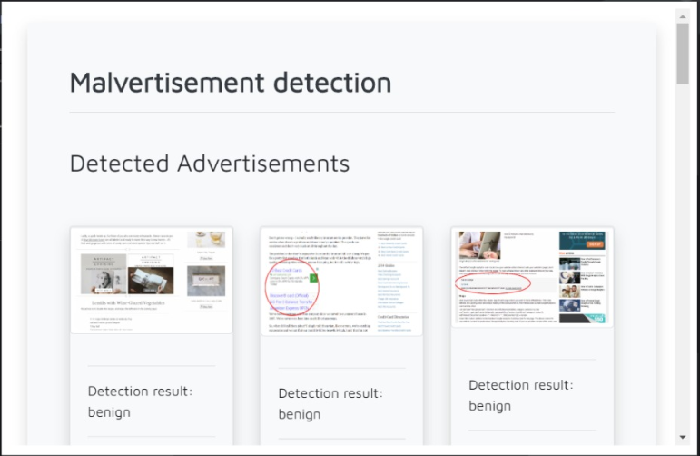
Output: Binary Classification
The trained NLP model is saved as “malclassifier.pkl” pickle file
Sparse matrix of trained data is stored in “count_vect”
This has been integrated into a simple webapp using flask
The folder containing the pictures of ads is selected to which the model generates an output

Slide 13
Future Scope/ Applications
Multiple Categorical Classification: Classification of text into multiple categories based on intent
Chrome extension: can be built to work as a layer over web pages and detect malicious ads while web browsing
Ad monitoring within deployed websites: can be added to websites to monitor ads on their platforms specifically
Website Integrity Checker: Can be used as a basis to blacklist (or whitelist) certain websites based on the kinds of ads they host.

Slide 14
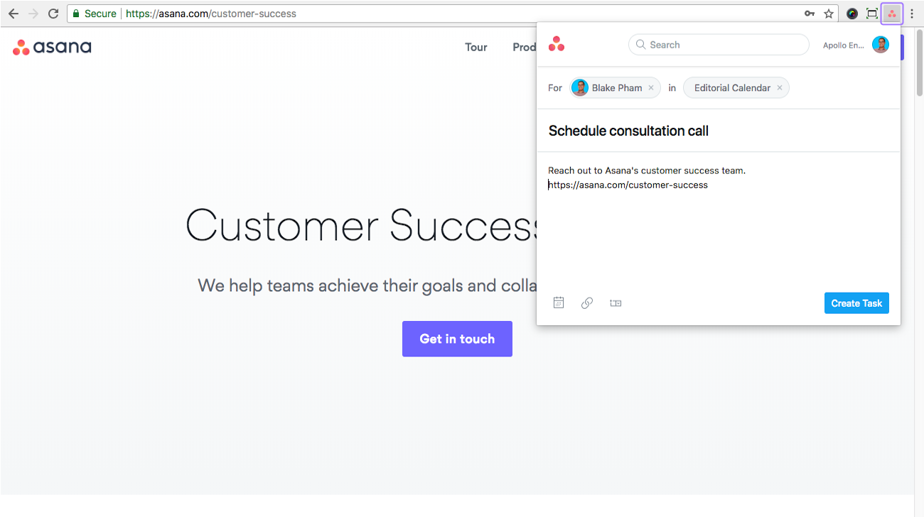
Front End
Chrome extension created as a practical application of the project to display the classification results.

Slide 15
Technology Stack
Python
Flask
Tesseract OCR
Scikit-learn library
Pickle module
SpaCy library
Selenium library
HTML
CSS

